Slide 1
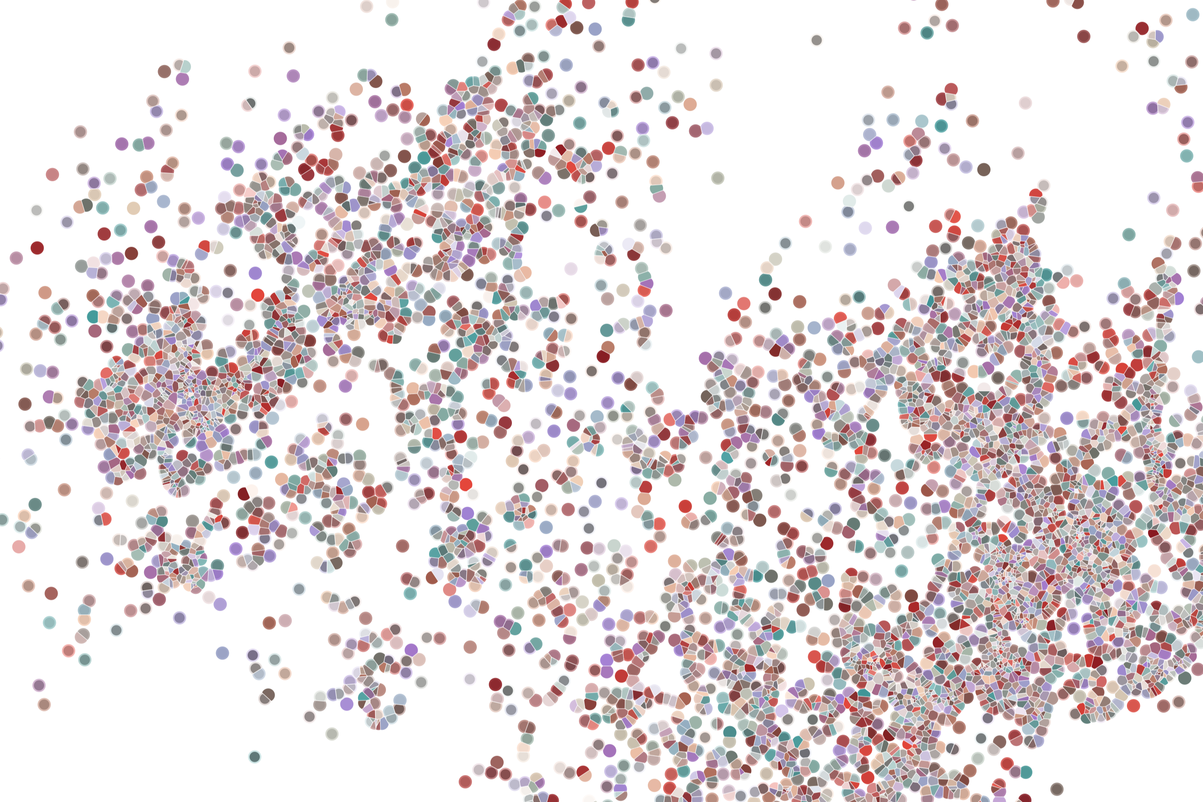
Lecture 1 Bulk chromatin accessibility: profiling local chromatin architecture and identifying regulatory elements
Physalia workshop 2021 — Bulk and single-cell ATAC-seq analysis
Instructor: Jacques Serizay
Notes:
Hello everybody and thank you for attending my presentation. I am going to talk about the project I recently started working on in the Spassky and Koszul labs, both located in Paris. This project focuses on the unusual cooption of the mitotic machinery to drive, not cell division but cell differentiation.

Slide 2

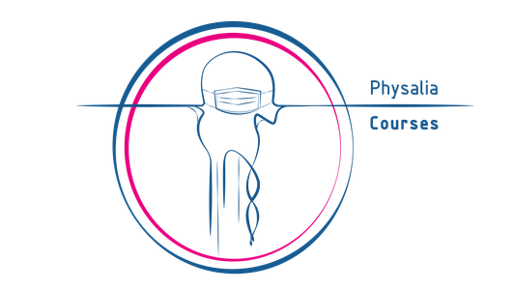
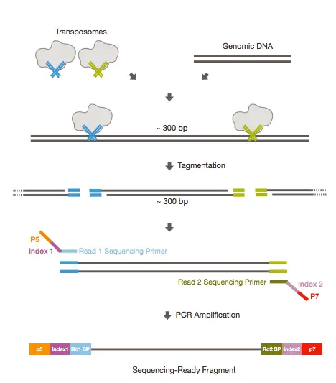
Bulk ATAC-seq processing
Processing
Notes:
I would like to expand these observations to in vivo data. I also want to check what happens in terms of transcriptional dynamics in cells where Cyclin O, a key non-canonical cyclin involved in MCC diff., is knocked-out.

Slide 3
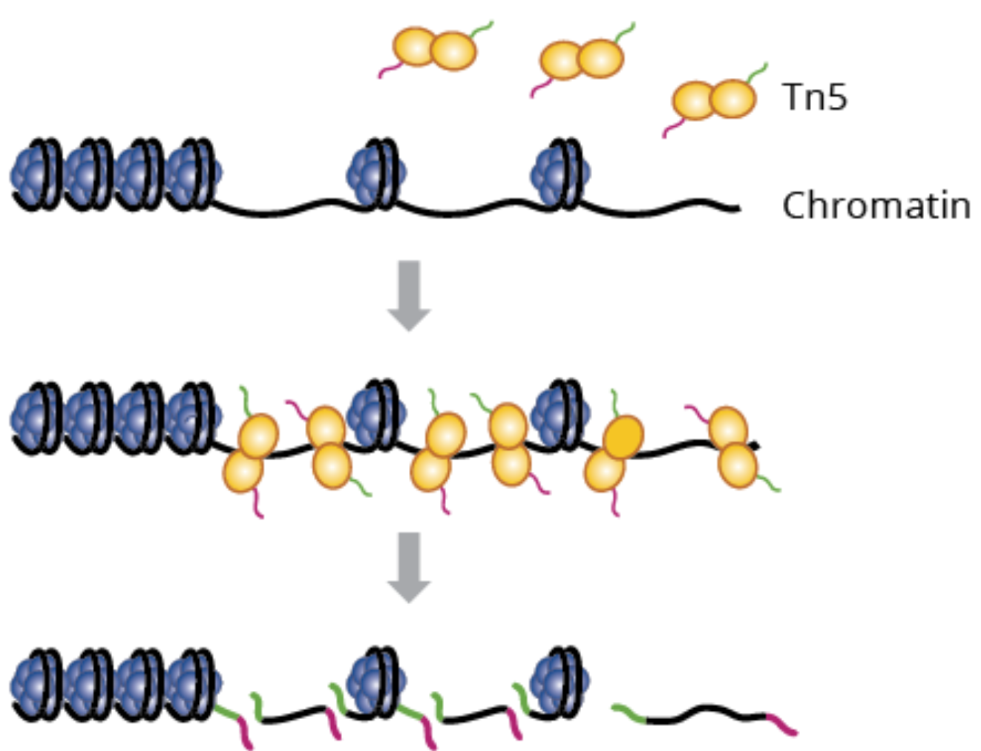
ATAC-seq: a “new” enzyme for a new assay
ATAC-seq stands for Assay for Transposase-Accessible Chromatin using sequencing.
3
Notes:
I would like to expand these observations to in vivo data. I also want to check what happens in terms of transcriptional dynamics in cells where Cyclin O, a key non-canonical cyclin involved in MCC diff., is knocked-out.

Slide 4
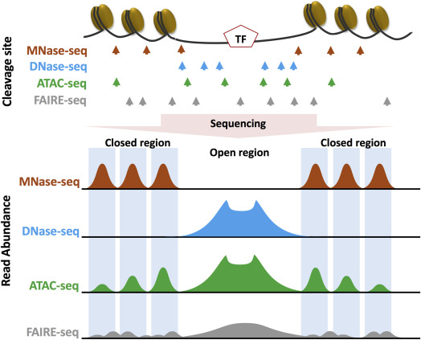
ATAC-seq: a “new” enzyme for a new assay
Other enzymatic (and mechanical) assays exist as well
Each assay gives a different answer about local chromatin organization.
Hsu et al., Epigenetics in Human Diseases 2018
4
Notes:
I would like to expand these observations to in vivo data. I also want to check what happens in terms of transcriptional dynamics in cells where Cyclin O, a key non-canonical cyclin involved in MCC diff., is knocked-out.

Slide 5
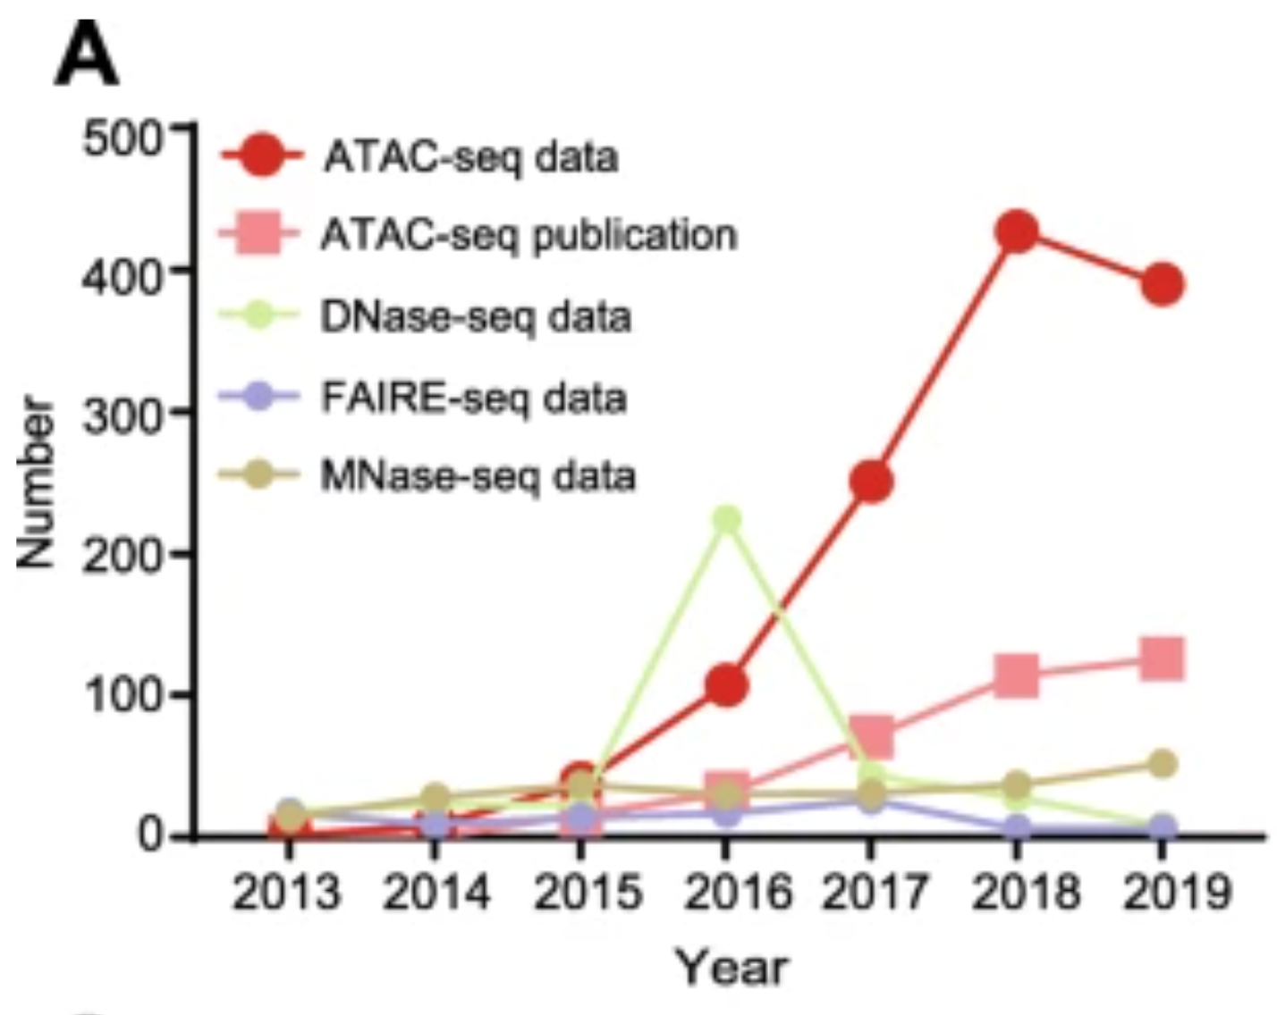
ATAC-seq: a “new” enzyme for a new assay
ATAC-seq is easily the most widely performed chromatin profiling assay, used in labs specialized in epigenomics but also in labs focusing on different biological fields (development, evolution, cancerology, immunology, non-model organisms, etc.)
Yan et al., Genome Biol. 2020
5
Notes:
I would like to expand these observations to in vivo data. I also want to check what happens in terms of transcriptional dynamics in cells where Cyclin O, a key non-canonical cyclin involved in MCC diff., is knocked-out.

Slide 6
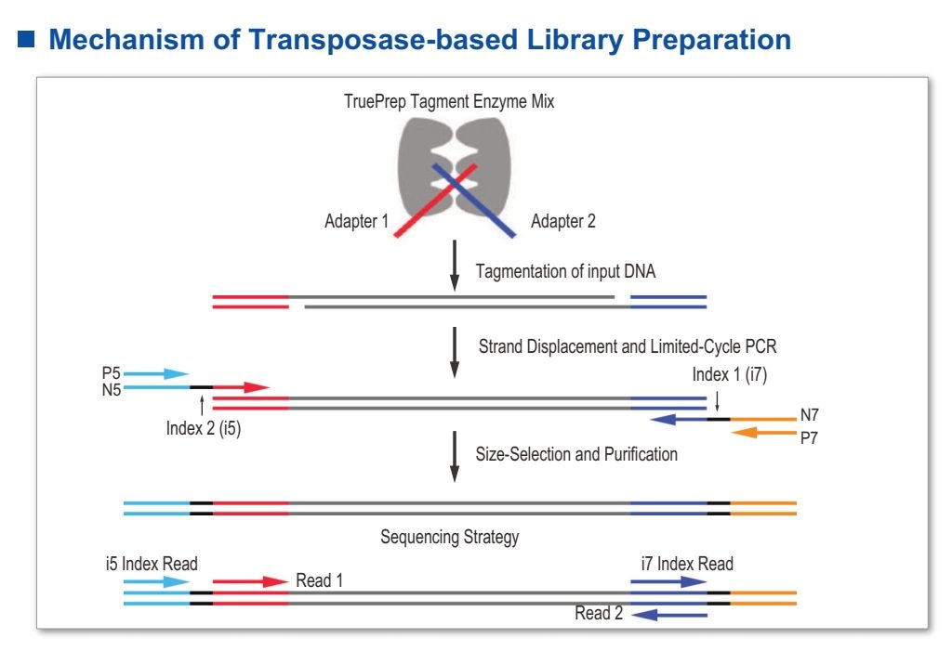
ATAC-seq is extraordinarily easy and informative
Once fresh (or frozen) cells are harvested, the transposition takes 30’, the clean-up takes ~15’, and the PCR takes < 2h.
The most “advanced” step is a quantitative PCR (optional!).
A sequencing-ready library can be ready in half a day.
Yan et al., Genome Biol. 2020
6
Notes:
I would like to expand these observations to in vivo data. I also want to check what happens in terms of transcriptional dynamics in cells where Cyclin O, a key non-canonical cyclin involved in MCC diff., is knocked-out.

Slide 7
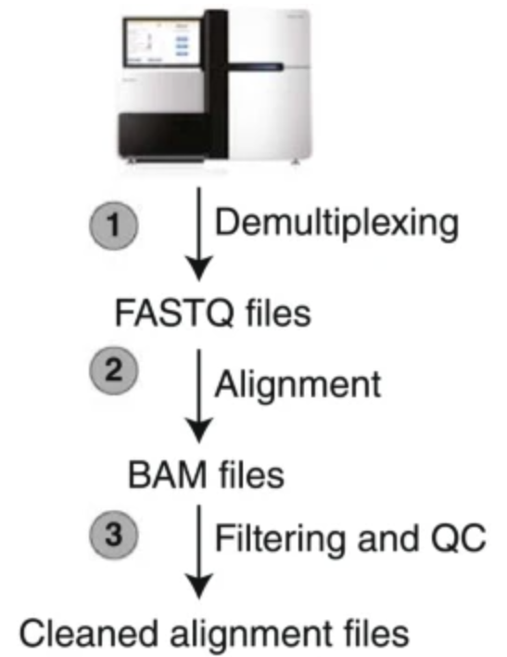
ATAC-seq sequencing data analysis
7
Notes:
I would like to expand these observations to in vivo data. I also want to check what happens in terms of transcriptional dynamics in cells where Cyclin O, a key non-canonical cyclin involved in MCC diff., is knocked-out.

Slide 8
ATAC-seq sequencing data analysis
Demultiplexing reads
Adaptor trimming
Fastq QC
Alignment
Filtering
Alignment QC
Peak calling
Track generation
8
Notes:
I would like to expand these observations to in vivo data. I also want to check what happens in terms of transcriptional dynamics in cells where Cyclin O, a key non-canonical cyclin involved in MCC diff., is knocked-out.

Slide 9
ATAC-seq sequencing data analysis
Demultiplexing reads
Adaptor trimming
Fastq QC
Alignment
Filtering
Alignment QC
Peak calling
Track generation
Bcl → fastq
Fastq → fastq
Fastq → Fastqc
Fastq → bam
Bam → bam
Bam → txt
Bam → bed *
Bam → bigiwg
9
Notes:
I would like to expand these observations to in vivo data. I also want to check what happens in terms of transcriptional dynamics in cells where Cyclin O, a key non-canonical cyclin involved in MCC diff., is knocked-out.

Slide 10
ATAC-seq sequencing data analysis
Demultiplexing reads
Adaptor trimming
Fastq QC
Alignment
Filtering
Alignment QC
Peak calling
Track generation
Bcl → fastq
Fastq → fastq
Fastq → Fastqc
Fastq → bam
Bam → bam
Bam → txt
Bam → bed *
Bam → bigiwg
(bcl2fastq)
trim_galore
FastQC
bowtie2
samtools
samtools
e.g. yapc
e.g. bedtools
10
Notes:
I would like to expand these observations to in vivo data. I also want to check what happens in terms of transcriptional dynamics in cells where Cyclin O, a key non-canonical cyclin involved in MCC diff., is knocked-out.

Slide 11
Peak calling
Most peak callers were designed before the emergence of ATAC-seq
Few of them directly aim at identifying peaks in chromatin accessibility signals
11
Notes:
I would like to expand these observations to in vivo data. I also want to check what happens in terms of transcriptional dynamics in cells where Cyclin O, a key non-canonical cyclin involved in MCC diff., is knocked-out.

Slide 12
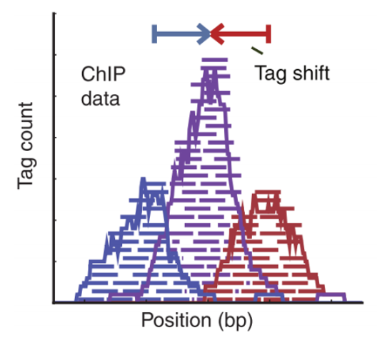
Peak calling
For instance, MACS2 primary goal is to find a model to shift single-end reads toward the real TF’s position
12
Notes:
I would like to expand these observations to in vivo data. I also want to check what happens in terms of transcriptional dynamics in cells where Cyclin O, a key non-canonical cyclin involved in MCC diff., is knocked-out.

Slide 13
Peak calling
Since the emergence of ATAC-seq, new peak callers were designed with the identification of peak “shape” in mind.
YAPC (yet another peak caller) computes the second derivate of the aggregated signal from multiple bigwigs, then find concave regions (corresponding to peaks).
13
Notes:
I would like to expand these observations to in vivo data. I also want to check what happens in terms of transcriptional dynamics in cells where Cyclin O, a key non-canonical cyclin involved in MCC diff., is knocked-out.

Slide 14
Peak calling
Since the emergence of ATAC-seq, new peak callers were designed with the identification of peak “shape” in mind.
YAPC (yet another peak caller) computes the second derivate of the aggregated signal from multiple bigwigs, then find concave regions (corresponding to peaks).
14
Notes:
I would like to expand these observations to in vivo data. I also want to check what happens in terms of transcriptional dynamics in cells where Cyclin O, a key non-canonical cyclin involved in MCC diff., is knocked-out.

Slide 15
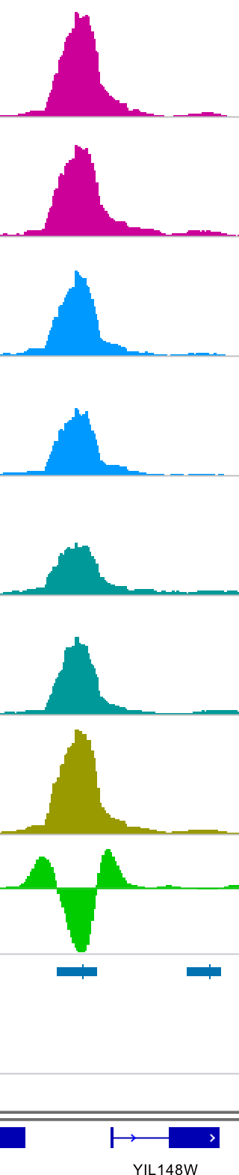
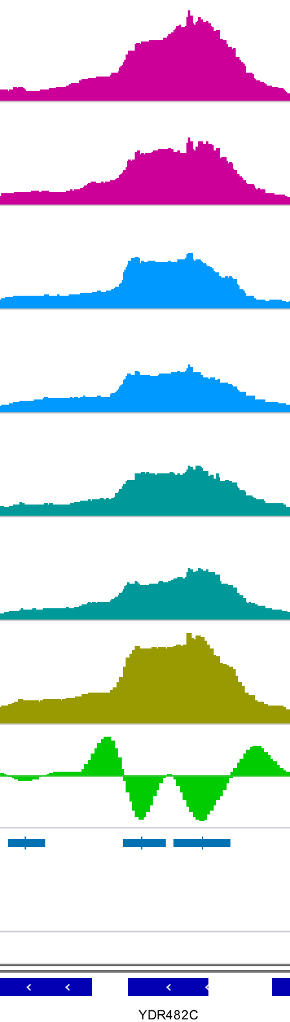
Peak calling
YAPC (yet another peak caller) computes the second derivate of the aggregated signal from multiple bigwigs, then find concave regions (corresponding to peaks).
Sample 1
Sample 2
Sample 3
Jänes et al., eLife 2018
15
Notes:
I would like to expand these observations to in vivo data. I also want to check what happens in terms of transcriptional dynamics in cells where Cyclin O, a key non-canonical cyclin involved in MCC diff., is knocked-out.

Slide 16
Peak calling
YAPC (yet another peak caller) computes the second derivate of the aggregated signal from multiple bigwigs, then find concave regions (corresponding to peaks).
Sample 1
Sample 2
Sample 3
Aggregated signal
Jänes et al., eLife 2018
16
Notes:
I would like to expand these observations to in vivo data. I also want to check what happens in terms of transcriptional dynamics in cells where Cyclin O, a key non-canonical cyclin involved in MCC diff., is knocked-out.

Slide 17
Peak calling
YAPC (yet another peak caller) computes the second derivate of the aggregated signal from multiple bigwigs, then find concave regions (corresponding to peaks).
Sample 1
Sample 2
Sample 3
Aggregated signal
2nd derivative
Jänes et al., eLife 2018
17
Notes:
I would like to expand these observations to in vivo data. I also want to check what happens in terms of transcriptional dynamics in cells where Cyclin O, a key non-canonical cyclin involved in MCC diff., is knocked-out.

Slide 18
Peak calling
YAPC (yet another peak caller) computes the second derivate of the aggregated signal from multiple bigwigs, then find concave regions (corresponding to peaks).
Sample 1
Sample 2
Sample 3
Aggregated signal
2nd derivative
Peaks
Gene annotations
Jänes et al., eLife 2018
18
Notes:
I would like to expand these observations to in vivo data. I also want to check what happens in terms of transcriptional dynamics in cells where Cyclin O, a key non-canonical cyclin involved in MCC diff., is knocked-out.

Slide 19
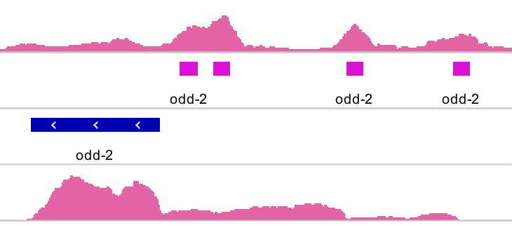
Functional annotations of chromatin accessible loci
Annotating the function of accessible chromatin loci (e.g. promoters or enhancers) is not straightforward
?
?
?
?
Jänes et al., eLife 2018
19
Notes:
I would like to expand these observations to in vivo data. I also want to check what happens in terms of transcriptional dynamics in cells where Cyclin O, a key non-canonical cyclin involved in MCC diff., is knocked-out.

Slide 20
Functional annotations of chromatin accessible loci
Annotating the function of accessible chromatin loci (e.g. promoters or enhancers) is not straightforward
Often, relying on complementary RNA-seq data appears to be helpful
E
E
P
P
?
?
?
?
Jänes et al., eLife 2018
20
Notes:
I would like to expand these observations to in vivo data. I also want to check what happens in terms of transcriptional dynamics in cells where Cyclin O, a key non-canonical cyclin involved in MCC diff., is knocked-out.

Slide 21
Any question?

